Slide 1
Biological Modeling of Neural Networks
Week 5: Networks of Neurons-Introduction
5.1 Introduction
- networks of neuron
- systems for computing
- associative memory
5.2 Classification by similarity
5.3 Detour: Magnetic Materials
5.4 Hopfield Model
5.5 Learning of Associations
5.6 Storage Capacity
Week 5
NETWORKS of NEURONS and
ASSOCIATIVE MEMORY
Wulfram Gerstner
EPFL, Lausanne, Switzerland
Notes:
The first part now took less than 35 minutes and leads up to the Swiss-cross exercise (1 pattern only!)
Second part: I started at 10:15 and took questions for exercise 1, and introduced the notation w_ij = p_i p_j that lead then naturally to the question of what can we do with several patters. I plugged in the weights in the dynamics and introduced the overlap; then I showed the demo, and explained why you should use random patterns. Then exercise 2 and 3
c) Third part: I started at 11:15 and showed how to do the calculation for exercise 3, explained orthogonality and why random patterns are nearly orthogonal. This then led over to the storage capacity for random patterns. I finished at 12:00

Slide 2
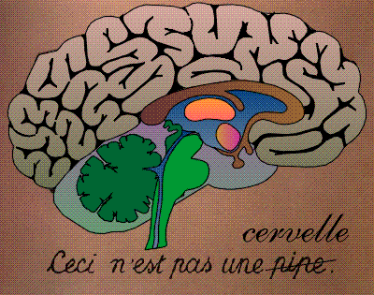
Systems for computing and information processing
Brain
Computer
memory
CPU
input
Distributed architecture
Von Neumann architecture
10
1 CPU
(10 proc. Elements/neurons)
10
(10 transistors)
No separation of
processing and memory

Slide 3
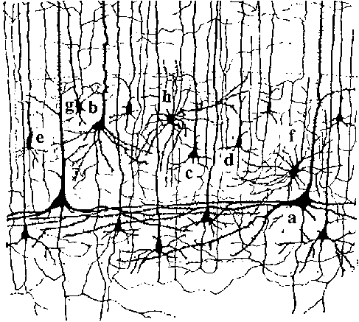
Systems for computing and information processing
1mm
10 000 neurons
3 km wire

Slide 4
Systems for computing and information processing
1mm
Brain
10 000 neurons
3 km wire
Distributed architecture
10
10 neurons
4
10 connections/neurons
No separation of
processing and memory

Slide 5
Associations, Associative Memory
Read this text NOW!
I find it rea*l* amazin* t*at y*u ar* abl* to re*d t*is tex* despit* th* fac* *hat more t*an t*ent* perc*n* of t** char*cte*s a*e mis*ing.
*his mean* t*at you* brai* i* abl* ** fill in missin* info*matio*.

Slide 6
pattern completion/word recognition
atom
brave
brain
brass
brai*
brain
Noisy word
List of words
Output the closest one
Your brain fills in missing information:
‘associative memory’

Slide 7
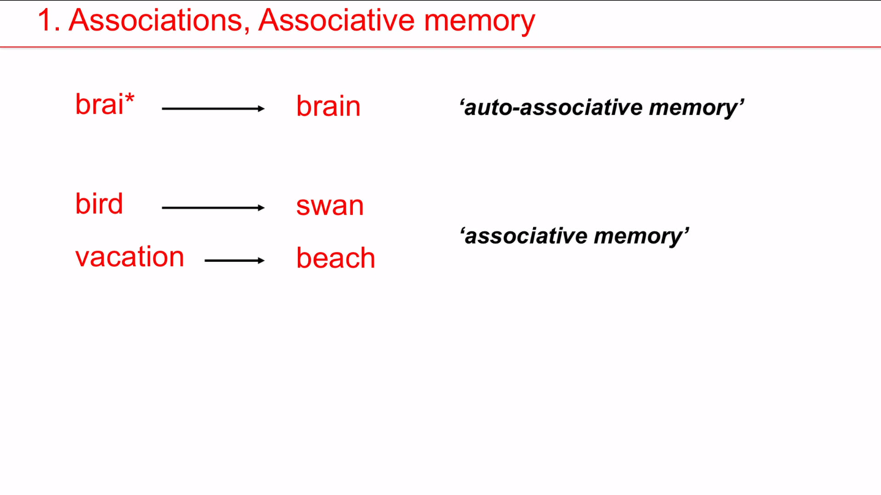

Slide 8
Biological Modeling of Neural Networks
Week 5: Networks of Neurons-Introduction
5.1 Introduction
- networks of neuron
- systems for computing
- associative memory
5.2 Classification by similarity
5.3 Detour: Magnetic Materials
5.4 Hopfield Model
5.5 Learning of Associations
5.6 Storage Capacity
Week 5
NETWORKS of NEURONS and
ASSOCIATIVE MEMORY
Wulfram Gerstner
EPFL, Lausanne, Switzerland
Notes:
The first part now took less than 35 minutes and leads up to the Swiss-cross exercise (1 pattern only!)
Second part: I started at 10:15 and took questions for exercise 1, and introduced the notation w_ij = p_i p_j that lead then naturally to the question of what can we do with several patters. I plugged in the weights in the dynamics and introduced the overlap; then I showed the demo, and explained why you should use random patterns. Then exercise 2 and 3
c) Third part: I started at 11:15 and showed how to do the calculation for exercise 3, explained orthogonality and why random patterns are nearly orthogonal. This then led over to the storage capacity for random patterns. I finished at 12:00

Slide 9
5.2 Classification by similarity: pattern recognition
A
B
Classification:
comparison
with prototypes
image
T
Z
Noisy image
Prototypes

Slide 10
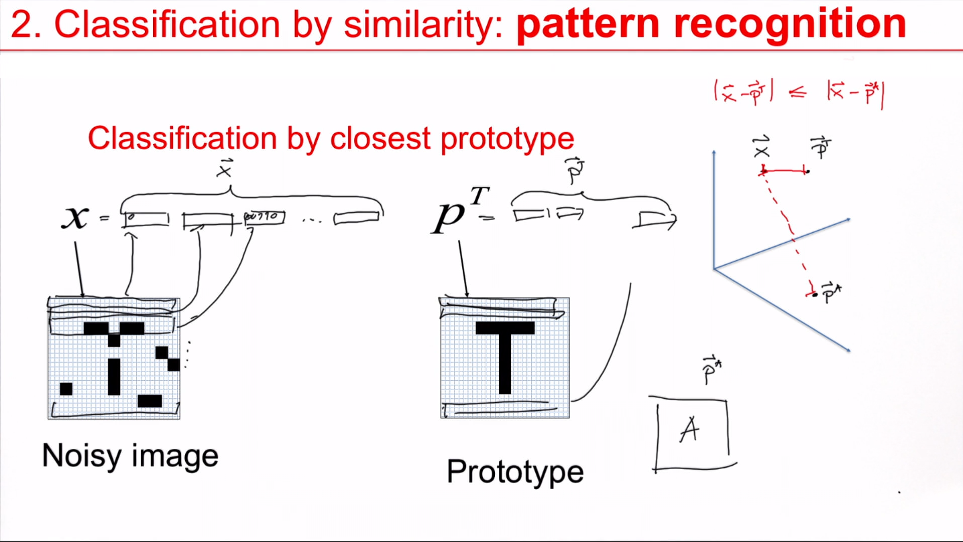

Slide 11
5.2 Classification by similarity: pattern recognition
Classification by closest prototype
Blackboard:
Noisy image
Prototypes

Slide 12
5.2 pattern recognition and Pattern completion
Aim: Understand Associative Memory
Associative
memory/
collective
computation
Noisy
image
Full
image
Partial
word
Full
word
Brain-style computation
Notes:
But we don't want to do it in this traditional algorithmic CPU based sequential manner, but we want to do it in a brain-style fashion. So in particular, we don't want to have a central controller that says either this or neither that running through a sequence of comparisons, what we want is that it's just the interactions between the different neurons. That takes out the closest prototype, and how to do this.

Slide 13
Quiz 5.1: Connectivity
A typical neuron in the brain makes connections
To 6-20 neighbors
To 100-200 neurons nearby
To more than 1000 neurons nearby
To more than 1000 neurons nearby or far away.
In a typical cristal in nature, each atom interacts
with 6-20 neighbors
with 100-200 neurons nearby
with more than 1000 neurons nearby
with more than 1000 neurons nearby or far away.

Slide 14
Biological Modeling of Neural Networks
Week 5: Networks of Neurons-Introduction
5.1 Introduction
- networks of neuron
- systems for computing
- associative memory
5.2 Classification by similarity
5.3 Detour: Magnetic Materials
5.4 Hopfield Model
5.5 Learning of Associations
5.6 Storage Capacity
Week 5
NETWORKS of NEURONS and
ASSOCIATIVE MEMORY
Wulfram Gerstner
EPFL, Lausanne, Switzerland
Notes:
The first part now took less than 35 minutes and leads up to the Swiss-cross exercise (1 pattern only!)
Second part: I started at 10:15 and took questions for exercise 1, and introduced the notation w_ij = p_i p_j that lead then naturally to the question of what can we do with several patters. I plugged in the weights in the dynamics and introduced the overlap; then I showed the demo, and explained why you should use random patterns. Then exercise 2 and 3
c) Third part: I started at 11:15 and showed how to do the calculation for exercise 3, explained orthogonality and why random patterns are nearly orthogonal. This then led over to the storage capacity for random patterns. I finished at 12:00

Slide 15
5.3 Detour: magnetism
N
S

Slide 16
5.3 Detour: magnetism
Noisy magnet
pure magnet

Slide 17
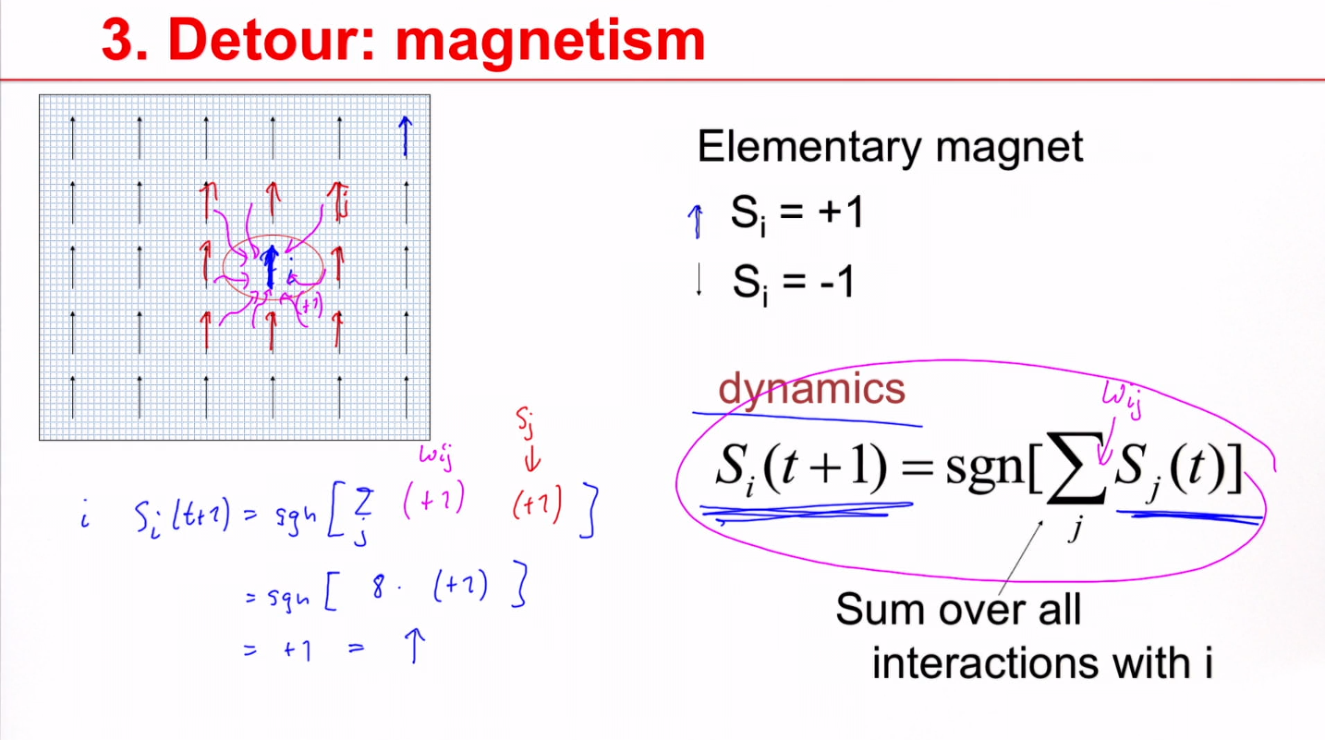
Notes:
You should be aligned with your neighbor

Slide 18
5.3 Detour: magnetism
Elementary magnet
S_{i} = +1
Blackboard:
example
S_{i} = -1
dynamics
Sum over all
interactions with i

Slide 19
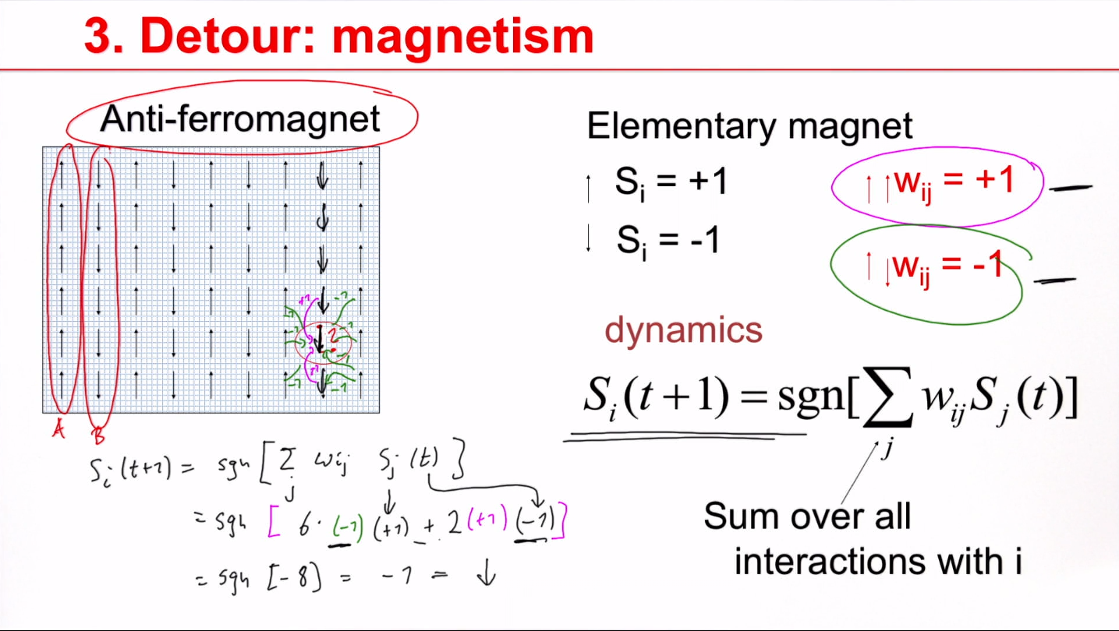

Slide 20
5.3 Detour: magnetism
Anti-ferromagnet
Elementary magnet
S_{i} = +1
w_{ij} = +1
S_{i} = -1
w_{ij} = -1
dynamics
Sum over all
interactions with i
blackboard

Slide 21
5.3 Magnetism and memory patterns
blackboard
Elementary pixel
w_{ij} = +1
S_{i} = +1
w_{ij} = +1
S_{i} = -1
w_{ij} = -1
dynamics
Hopfield model:
Several patterns→ next section
Sum over all
interactions with i

Slide 22
Exercise 1: Associative memory (1 pattern)
Next lecture at
10h15
Elementary pixel
w_{ij} = +1
S_{i} = +1
w_{ij} = +1
S_{i} = -1
dynamics
9 neurons
- define appropriate weights
- what happens if one neuron wrong?
- what happens if n neurons wrong?
Sum over all
interactions with i

Slide 23
Biological Modeling of Neural Networks
Week 5: Networks of Neurons-Introduction
5.1 Introduction
- networks of neuron
- systems for computing
- associative memory
5.2 Classification by similarity
5.3 Detour: Magnetic Materials
5.4 Hopfield Model
5.5 Learning of Associations
5.6 Storage Capacity
Week 5
NETWORKS of NEURONS and
ASSOCIATIVE MEMORY
Wulfram Gerstner
EPFL, Lausanne, Switzerland
Notes:
THIS IS THE Second part: I started at 10:15 and took questions for exercise 1, and introduced the notation w_ij = p_i p_j that lead then naturally to the question of what can we do with several patters. I plugged in the weights in the dynamics and introduced the overlap; then I showed the demo, and explained why you should use random patterns. Then exercise 3 (four orthogonal patterns).
c) Third part: I started at 11:15 and showed how to do the calculation for exercise 3, explained orthogonality and why random patterns are nearly orthogonal. This then led over to the storage capacity for random patterns. I finished at 12:00

Slide 24
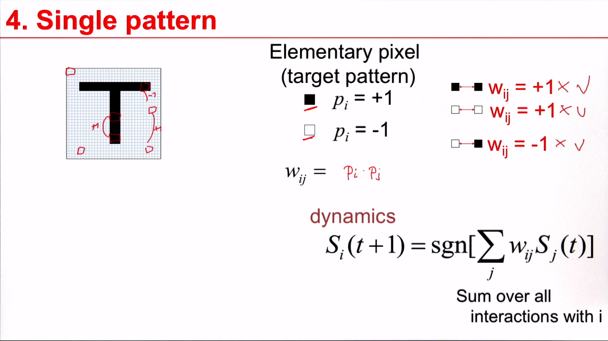

Slide 25
5.4 Hopfield Model of Associative Memory
interactions
Sum over all
prototypes
dynamics
Prototype
p¹
Prototype
p²
Hopfield model
Sum over all
interactions with i

Slide 26
5.4 Hopfield Model of Associative Memory
This rule
is very good
for random
patterns
interactions
It does not work well
for correlated patters
Sum over all
prototypes
Prototype
p¹
DEMO
dynamics
Random patterns, fully connected:
Hopfield model
all interactions with i
Notes:
We should think just have a pattern as a random combination somewhere in the brain, some neurons are on somewhere in the brain, some neurons are off. And this combination of on and off corresponds to a certain pattern to a certain prototype.
I can store several random patterns, the probability that if a black pixel is 50%, probably 0.5
I have a fully connected network, which means each pixel connects to all other pixels, even if they are far away.

Slide 27
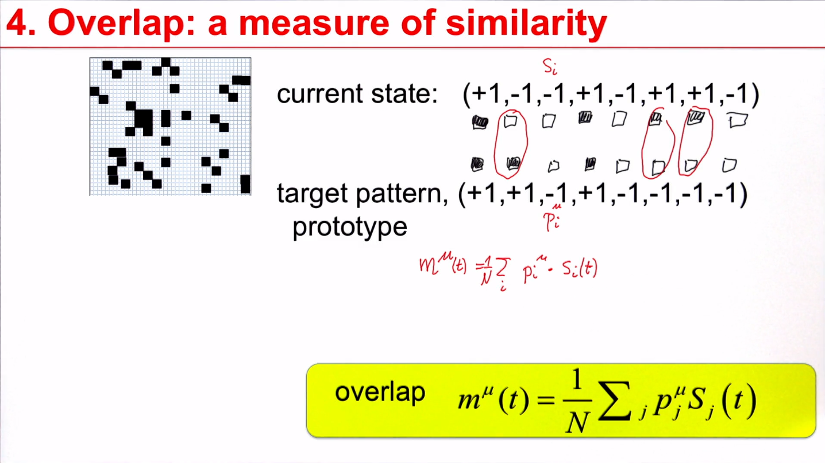
Notes:
The algorithmic approach is finding the closest prototype that you need to compare the current state with the target patterns with a prototype.

Slide 28
5.4 Hopfield Model of Associative Memory
Blackboard
overlap

Slide 29
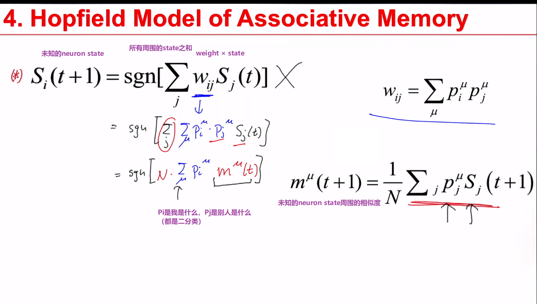

Slide 30
5.4 Hopfield Model of Associative Memory
Interacting neurons
Prototype
p¹
Finds the closest prototype
i.e. maximal overlap
(similarity)
Computation
- without CPU,
- without explicit
memory unit
Hopfield model

Slide 31
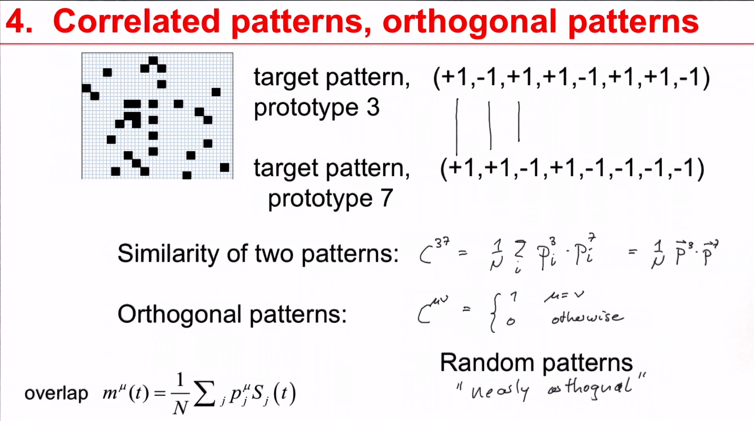
Notes:
其实就是用dot product看相似度

Slide 32
Exercise 3 (now)
Next lecture at
11h15
Prototype
p¹
Sum over all
interactions with i
Assume 4 patterns. At time t=0, overlap with
Pattern 3, no overlap with other patterns.
discuss temporal evolution (of overlaps)
(assume that patterns are orthogonal)
Notes:
I arrived here at 10:45

Slide 33
Biological Modeling of Neural Networks
Week 5-5: Learning of Associations
5.1 Introduction
- networks of neuron
- systems for computing
- associative memory
5.2 Classification by similarity
5.3 Detour: Magnetic Materials
5.4 Hopfield Model
5.5 Learning of Associations
5.6 Storage Capacity
Week 5
NETWORKS of NEURONS and
ASSOCIATIVE MEMORY
Wulfram Gerstner
EPFL, Lausanne, Switzerland
Notes:
c) Third part: I started at 11:15 and showed how to do the calculation for exercise 3, explained orthogonality and why random patterns are nearly orthogonal. This then led over to the storage capacity for random patterns. I finished at 12:00

Slide 34
5.5 Learning of Associations
Where do the connections come from?
pre j
i
k
post
Hebbian Learning
When an axon of cell j repeatedly or persistently
takes part in firing cell i, then j’s efficiency as one
of the cells firing i is increased
Hebb, 1949
- local rule
- simultaneously active (correlations)

Slide 35
5.5 Hebbian Learning of Associations

Slide 36
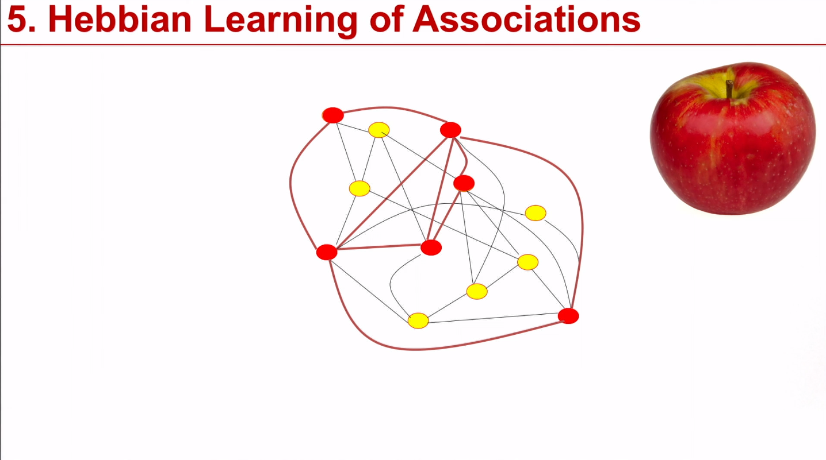

Slide 37
5.5 Hebbian Learning of Associations
item memorized

Slide 38
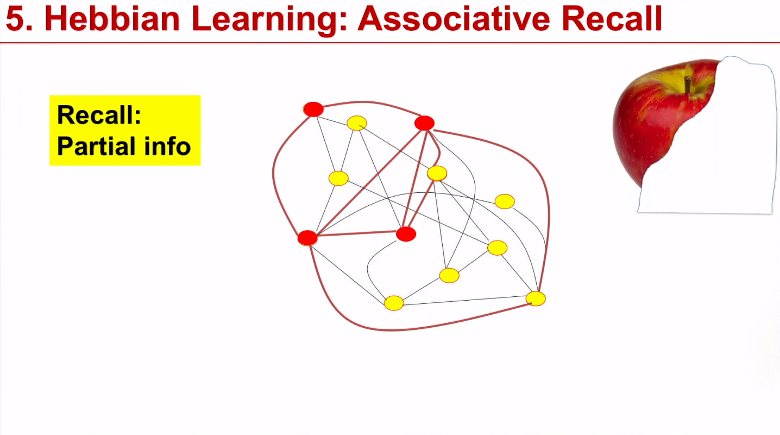

Slide 39
5.5 Hebbian Learning: Associative Recall
Recall:
Partial info
item recalled

Slide 40
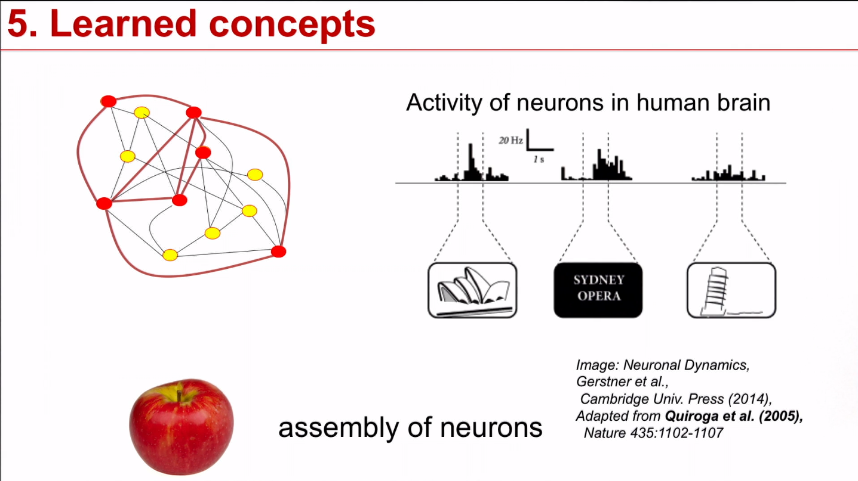
Notes:
These strong connections connected neurons that represent the concept of an apple in their connections; they also called an assembly and assembly that represent the apple concept.

Slide 41
5.5 Associative Recall
Tell me the color
for the following list of 5 items:
Tell me the object shape
for the following list of 5 items:
be as fast as possible:
time

Slide 42
5.5 Associative Recall
Tell me the color
for the following list of 5 items:
Red
Blue
Yellow
Green
Red
be as fast as possible:
time
Stroop effect:
Slow response: hard to work
Against natural associations

Slide 43
5.5 Associative Recall
Hierarchical organization of
Associative memory
animals
birds
fish
Name as fast as possible
an example of a bird
swan (or goose or raven or …)
Write down first letter: s for swan or r for raven …

Slide 44
5.5 Associative Recall
Nommez au plus vite possible
un exemple d’un /d’une
name as fast as possible
an example of a
outil
tool
hammer
red
Apple
violin
couleur
color
fruit
fruit
instrument
de musique
music
instrument

Slide 45
Biological Modeling of Neural Networks
Week 5-5: Learning of Associations
5.1 Introduction
- networks of neuron
- systems for computing
- associative memory
5.2 Classification by similarity
5.3 Detour: Magnetic Materials
5.4 Hopfield Model
5.5 Learning of Associations
5.6 Storage Capacity
Week 5
NETWORKS of NEURONS and
ASSOCIATIVE MEMORY
Wulfram Gerstner
EPFL, Lausanne, Switzerland
Notes:
THIS IS THE Third part: I started at 11:30 and moved to the storage capacity for random patterns. I finished at 12:00

Slide 46
learning of prototypes
interactions
(1)
Prototype
p¹
Prototype
p²
Sum over all
prototypes
Q; How many prototypes can be stored?
dynamics
all interactions with i
Notes:
下一个时间点的状态 = 权重（大脑的网络链接，也就是我们储存的所有原型） · 这一个时间点的状态（input）
不断迭代最后得到一个大脑中的原型

Slide 47
Q; How many prototypes can be stored?
blackboard
Random patterns
Prototype
p¹
Prototype
p²
Interactions (1)
Dynamics (2)
Minimal condition: pattern is fixed point of dynamics
Assume we start directly in one pattern
Pattern stays
Attention: Retrieval requires more (pattern completion)
Notes:
我们从一个噪音的版本开始，慢慢让他自我纠正成一个我们脑中的prototypes

Slide 48
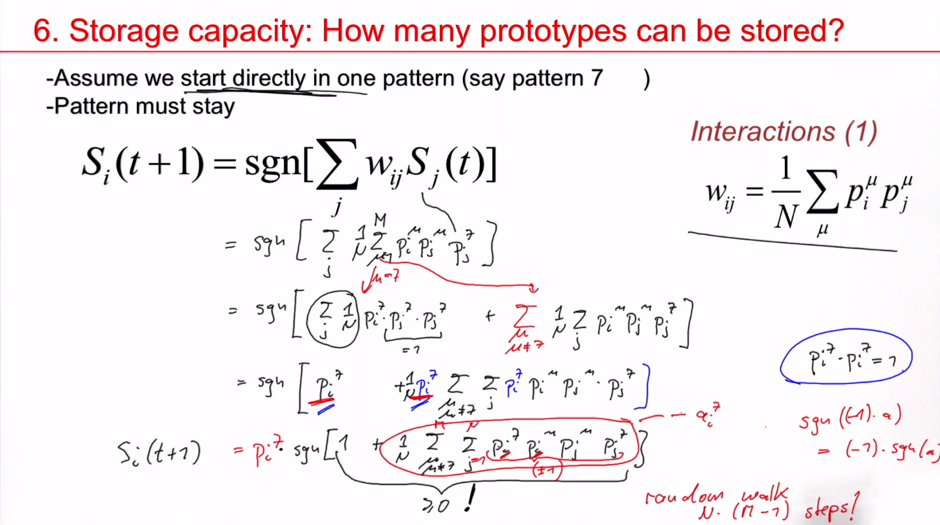
Notes:
这里我们假设我们起始的state s(t) 它就是第7个的pattern，也就是说each neuron is in this state that‘s consistent with this pattern 7.
也就是从后面来看，他这里面就是一堆+1和-1的random work，也就是储存的原型越多，波动的标准差就越大，然后就越可能出错。

Slide 49
Week 6 Review: storage capacity of Hopfield model
Random patterns
Prototype
p¹
Prototype
p²
Interactions (1)
Dynamics (2)
Minimal condition: pattern is fixed point of dynamics
Assume we start directly in one pattern
Pattern stays
Attention: Retrieval requires more (pattern completion)

Slide 50
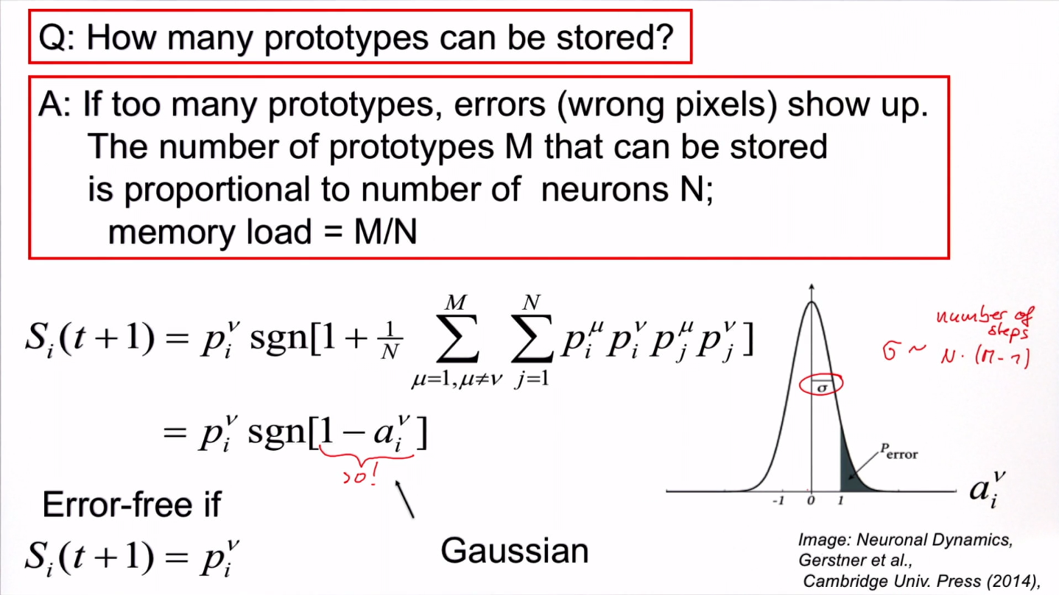

Slide 51
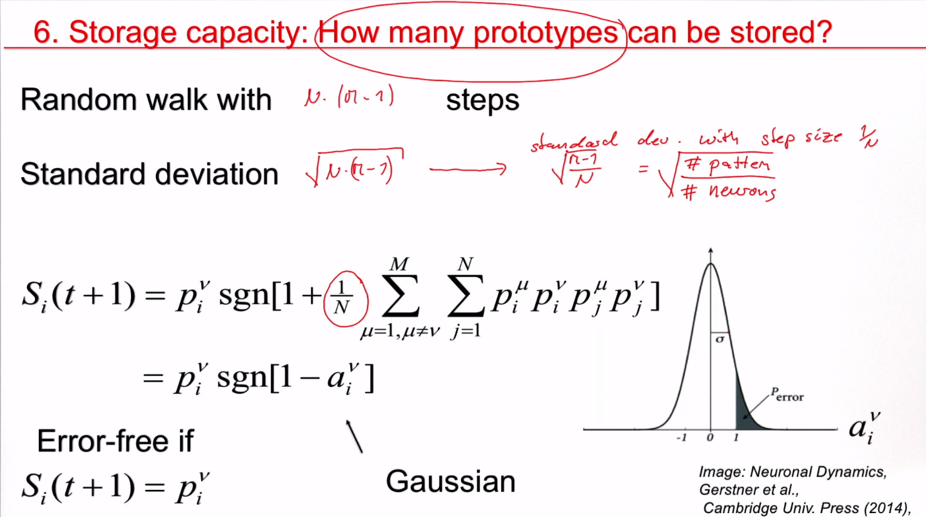

Slide 52
Q; How many prototypes can be stored?
0
1

Slide 53
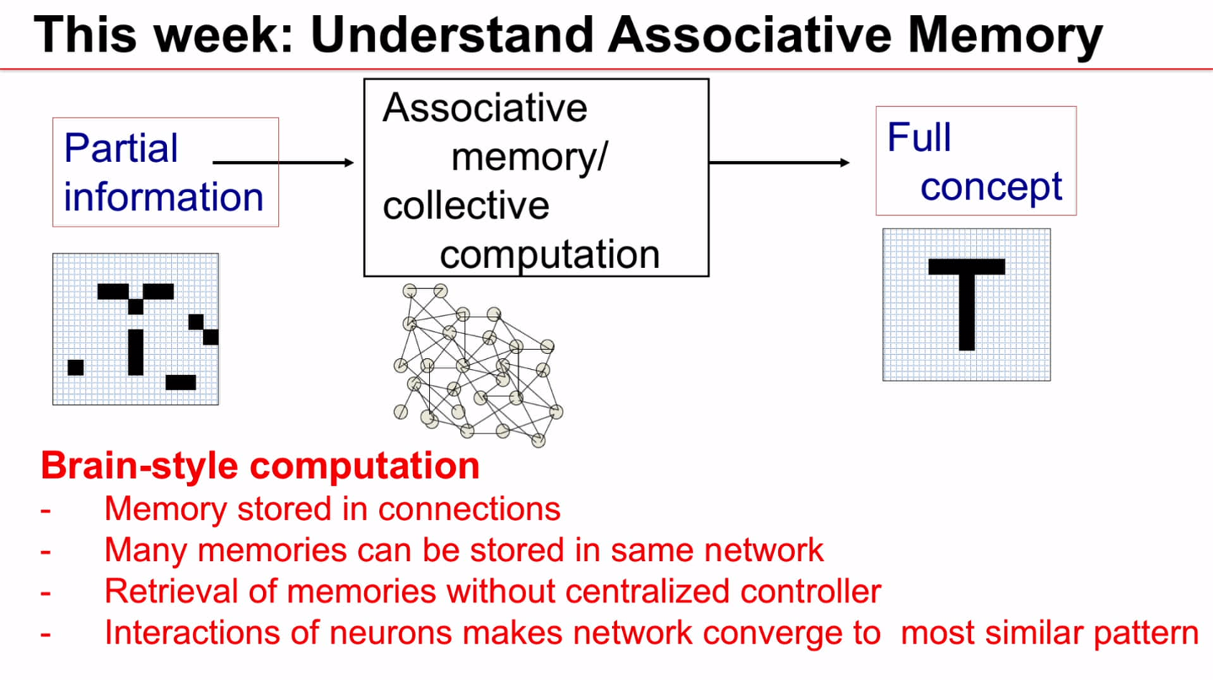

Slide 54
Exercise 4 now: Associative memory
Q; How many prototypes can be stored?
End of lecture, exercise+
Computer exercise : 12:00
Prototype
p¹
Prototype
p²
Interactions (1)
Dynamics (2)
Random patterns → random walk
a) show relation to erf function: importance of p/N
b) network of 1000 neurons – allow at most 1 wrong pixel?
c) network of N neurons – at most 1 promille wrong pixels?

Slide 55
Biological Modeling of Neural Networks
Week 6: Hopfield model continued
6.1 Stochastic Hopfield Model
6.2. Energy landscape
6.3. Low-activity patterns
6.4. Attractor memorie
- spiking neurons
- experimental data
Week 6
Hebbian LEARNING and
ASSOCIATIVE MEMORY
Wulfram Gerstner
EPFL, Lausanne, Switzerland

Slide 56
6.1 Review: Hopfield model
interactions
(1)
Prototype
p¹
Prototype
p²
Sum over all
prototypes
Deterministic dynamics

Slide 57
6.1 Stochastic Hopfield model
Random patterns
Prototype
p¹
Prototype
p²
Interactions (1)
Dynamics (2)
blackboard

Slide 58
6.1 Stochastic Hopfield model: memory retrieval
Notes:
And if I take beta to infinity, then it really goes back to a step function. And this is the situation that would correspond to the deterministic model.

Slide 59
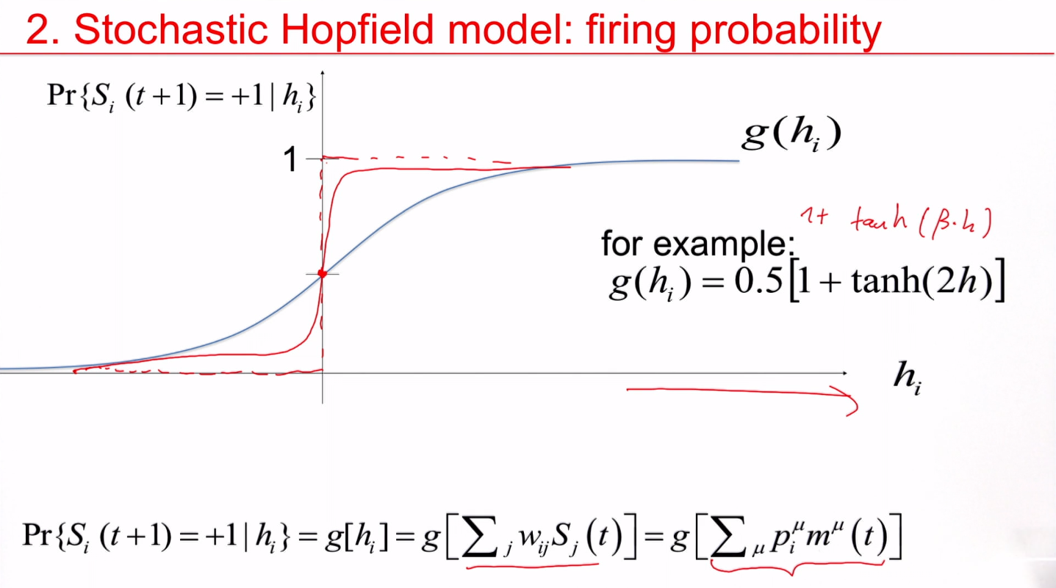
Notes:
And if I take beta to infinity, then it really goes back to a step function. And this is the situation that would correspond to the deterministic model.

Slide 60
6.1 Stochastic Hopfield model: memory retrieval
Notes:
每一种state都会收敛到一个fix point

Slide 61
6.1 Stochastic Hopfield model
Dynamics (2)
blackboard
Assume that there is only overlap with pattern 17:
two groups of neurons: those that should be ‘on’ and ‘off’

Slide 62
6.1 Stochastic Hopfield model: memory retrieval

Slide 63
Biological Modeling of Neural Networks
Week 6: Hopfield model continued
6.1 Stochastic Hopfield Model
6.2. Energy landscape
6.3. Low-activity patterns
6.4. Attractor memorie
- spiking neurons
- experimental data
Week 6
Hebbian LEARNING and
ASSOCIATIVE MEMORY
Wulfram Gerstner
EPFL, Lausanne, Switzerland

Slide 64
6.2 memory retrieval

Slide 65
6.2 Symmetric interactions: Energy picture
E

Slide 66
Exercise 2 now: Energy picture
E
Next lecture
11:25
Notes:
The third lecture takes 30 minutes. Therefore three possiblities
Exercise until 11:25 and 5 minute explanation
No exercise
Exercise starts before break

Slide 67
Biological Modeling of Neural Networks
Week 6: Hopfield model continued
6.1 Stochastic Hopfield Model
6.2. Energy landscape
6.3. Low-activity patterns
6.4. Attractor memories
- spiking neurons
- experimental data
Week 6
Hebbian LEARNING and
ASSOCIATIVE MEMORY
Wulfram Gerstner
EPFL, Lausanne, Switzerland

Slide 68
6.3 Attractor memory

Slide 69
6.3 attractor memory with spiking neurons
Memory with spiking neurons
Mean activity of patterns?
Separation of excitation and inhibition?
Modeling?
Neural data?

Slide 70
6.3 attractor memory with low activity patterns
1
2 …
i …
N
μ=1
μ=2
μ=3
Random patterns +/-1 with zero mean →
50 percent of neurons should be active in each pattern

Slide 71
1
2 …
i …
N
μ=1
μ=2
μ=3
Random patterns +/-1 with low activity (mean =a<0) →
20 percent of neurons should be active in each pattern
Some constant
activity

Slide 72
Biological Modeling of Neural Networks
Week 6: Hopfield model continued
6.1 Stochastic Hopfield Model
6.2. Energy landscape
6.3. Low-activity patterns
6.4. Attractor memories
- spiking neurons
- experimental data
Week 6
Hebbian LEARNING and
ASSOCIATIVE MEMORY
Wulfram Gerstner
EPFL, Lausanne, Switzerland

Slide 73
6.4 attractor memory with spiking neurons
Inh1
Inh1
Exc
Inh2
Hebb-rule:
Active together
Inh2
theta

Slide 74
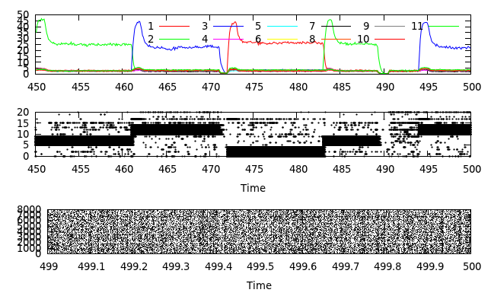
Overlap with patterns 1 … 3
Spike raster

Slide 75
Overlap with patterns 1 … 11 (80 patterns stored!)
overlaps
Spike raster

Slide 76
Memory with spiking neurons
Low activity of patterns?
Separation of excitation and inhibition?
Modeling?
Neural data?
All possible

Slide 77
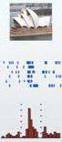
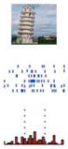
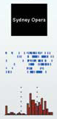
6.4 memory data
Human Hippocampus
Sidney opera
Sidney opera
Sidney opera
Quiroga, R. Q., Reddy, L., Kreiman, G., Koch, C., and Fried, I. (2005).
Invariant visual representation by single neurons in the human brain.
Nature, 435:1102-1107.

Slide 78
6.4 memory data
Delayed Matching to Sample Task
Animal experiments
sample
1s
match
sample
1s
match

Slide 79
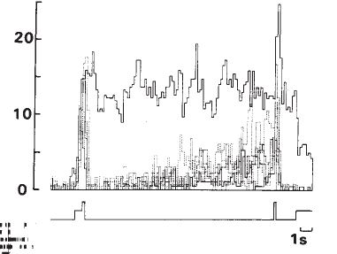
6.4 memory data
20
[Hz]
sample
1s
match
Miyashita, Y. (1988). Neuronal correlate of visual associative long-term memory in the primate temporal cortex. Nature, 335:817-820.

Slide 80
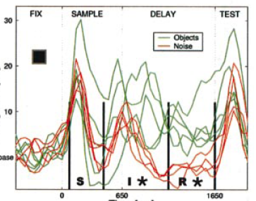
6.4 memory data
20
[Hz]
0
0
1650ms
sample
match
Rainer and Miller (2002). Timecourse of object-related neural activity in the primate
prefrontal cortex during a short-term memory task. Europ. J. Neurosci., 15:1244-1254.

Slide 81
Exercise 3 NOW- from Hopfield to spikes
In the Hopfield model, neurons are characterized by a binary variable Si = +/-1. For an interpretation in terms of spikes it is, however, more appealing to work with a binary variable xi which is zero or 1.
(i) Write Si = 2xi- 1 and rewrite the Hopfield model in terms of xi.
What are the conditions so that the input potential is
(ii) Repeat the same calculation for low-activity patterns and
and weights
with some constants a and b

Slide 82
The end

